Slide 1
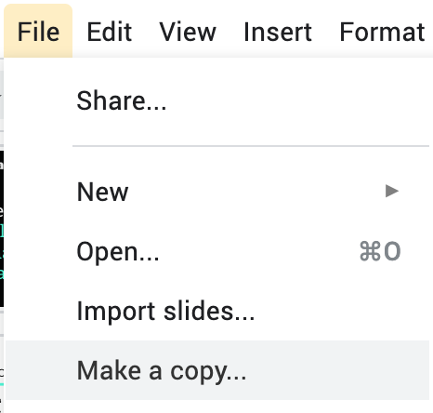
How to Use This Template
To create your own copy of the template to edit, go to File > Make a copy
Edit the information on the slides to fit your buyer personas.
Delete this slide for a professional presentation for your team!

Slide 2
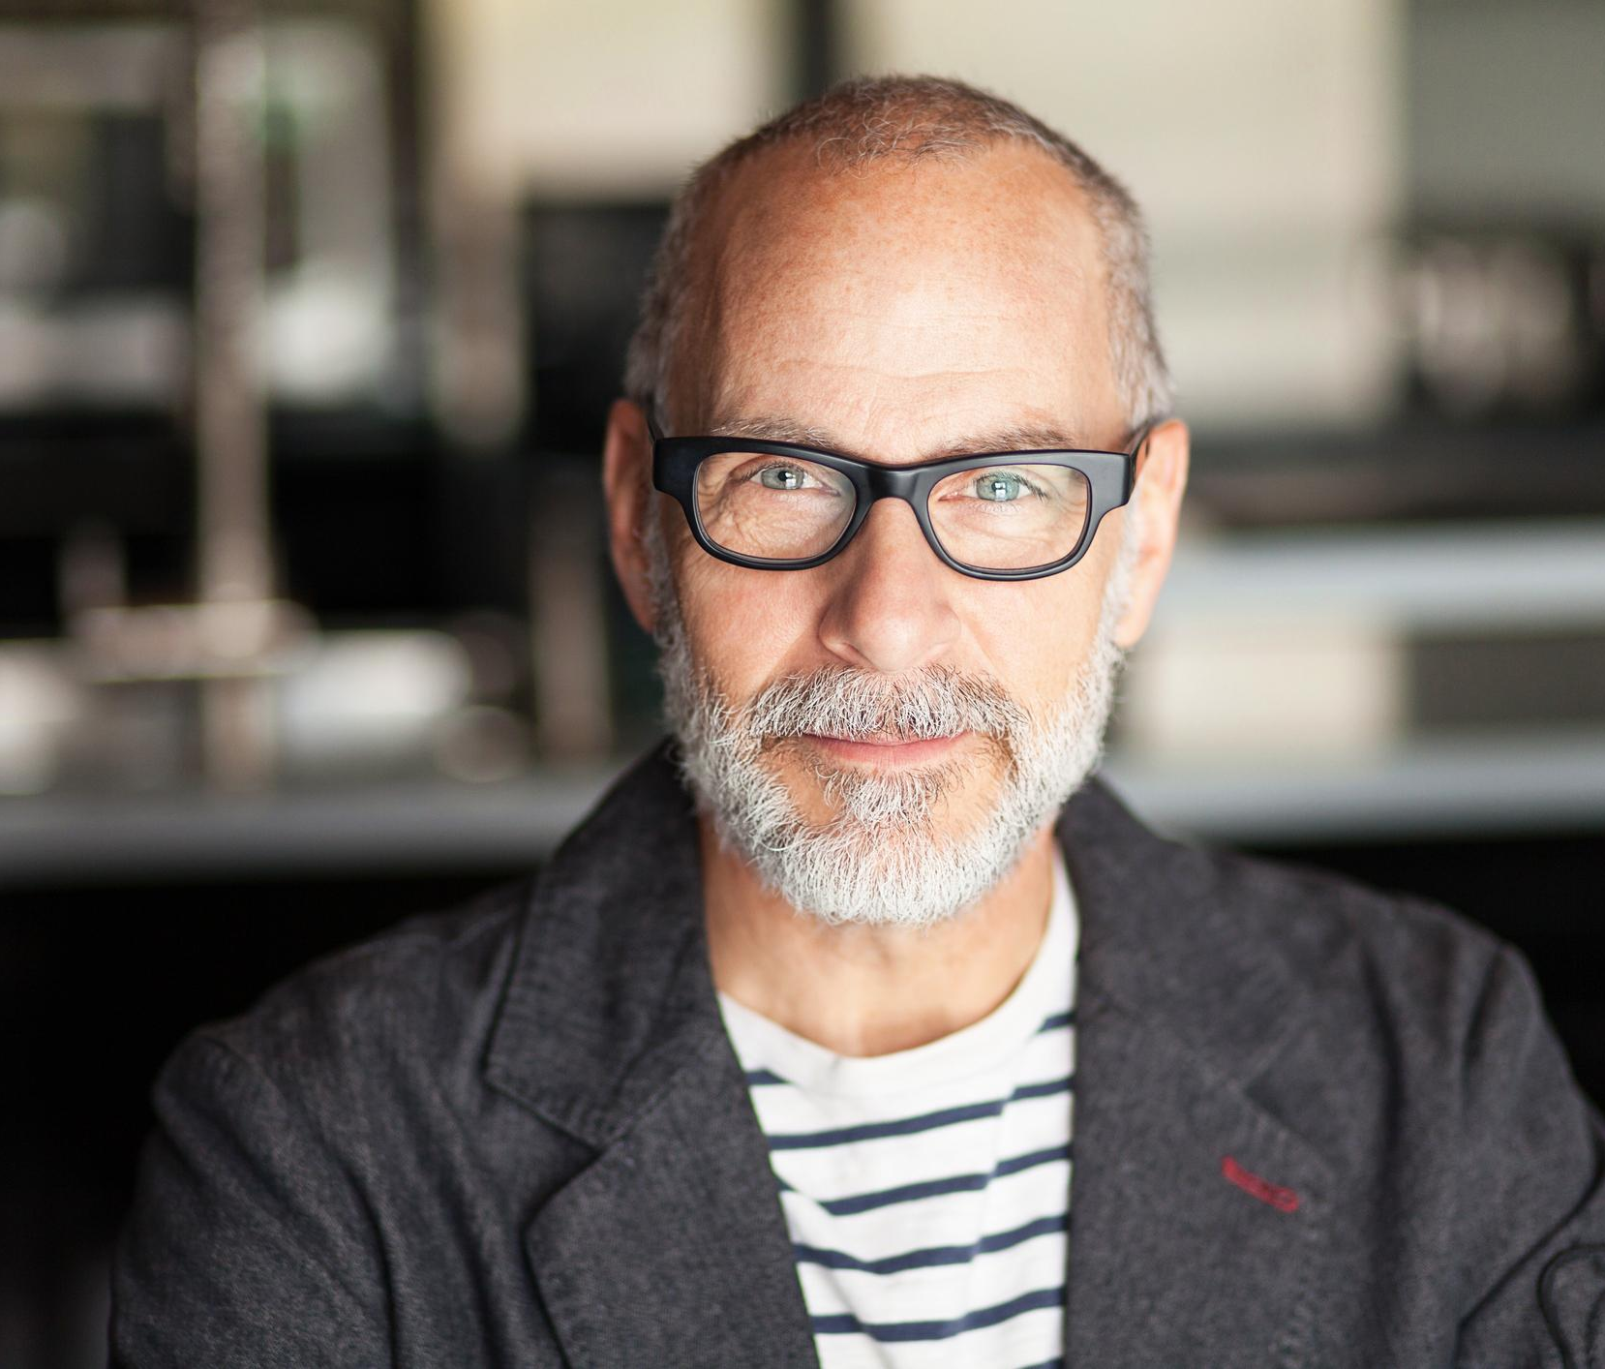
AGE RANGE
GENDER
COMPANY REVENUE/PROFIT
URBANICITY
EDUCATION
PROFESSIONAL ROLE
40-55+ Years
Male
$35 million / $350,000
Urban
Master's degree
Business Owner and CEO
Small Business Sam
COMPANY SIZE
Background Simon is a small business owner in his late 40s to mid 50s. His business has $5 million to $35 million in revenue, $300,000 to $400,000 in net profit, and has five to 30 employees. He is primarily focused on reducing his business taxes so he can retain more of his profits. Simon is responsible for managing business operations, finances, cash flow, and taxes. He and his wife want to make informed decisions for business growth, save money for retirement, pay off their mortgage and pay for their children to go to college. He needs help with his business finances and has maxed out what he can do on his own.
Goals
Save money on his taxes
Close the gap between his business and personal finances
Consolidate his multiple financial service providers
Challenges
Has difficulty trusting someone else with the financial future of his business
Fears making the wrong decision
Afraid of change
Does not like to take risks
Limited with the time he can spend on planning for the future because he has to run his business
Skeptical about the cost of financial services
How Our Company Can Help
Lower business taxes
Improve cash flow and financial planning
Become a trusted advisor
Provide seamless service and convenience by managing personal and business finances under one firm
SMALL
LARGE
BUYING POWER
INFLUENCER
DECISION MAKER
SCHEDULE AVAILABILITY
AMPLE
LIMITED
KEY IDENTIFIERS
Wants fee only services
Seeks one firm to manage all finances
Doesn’t want to manage finances himself
Focused on business taxes
RISK TAKER
YES
NO
COMPANY ADVOCATE
YES
NO

Slide 3
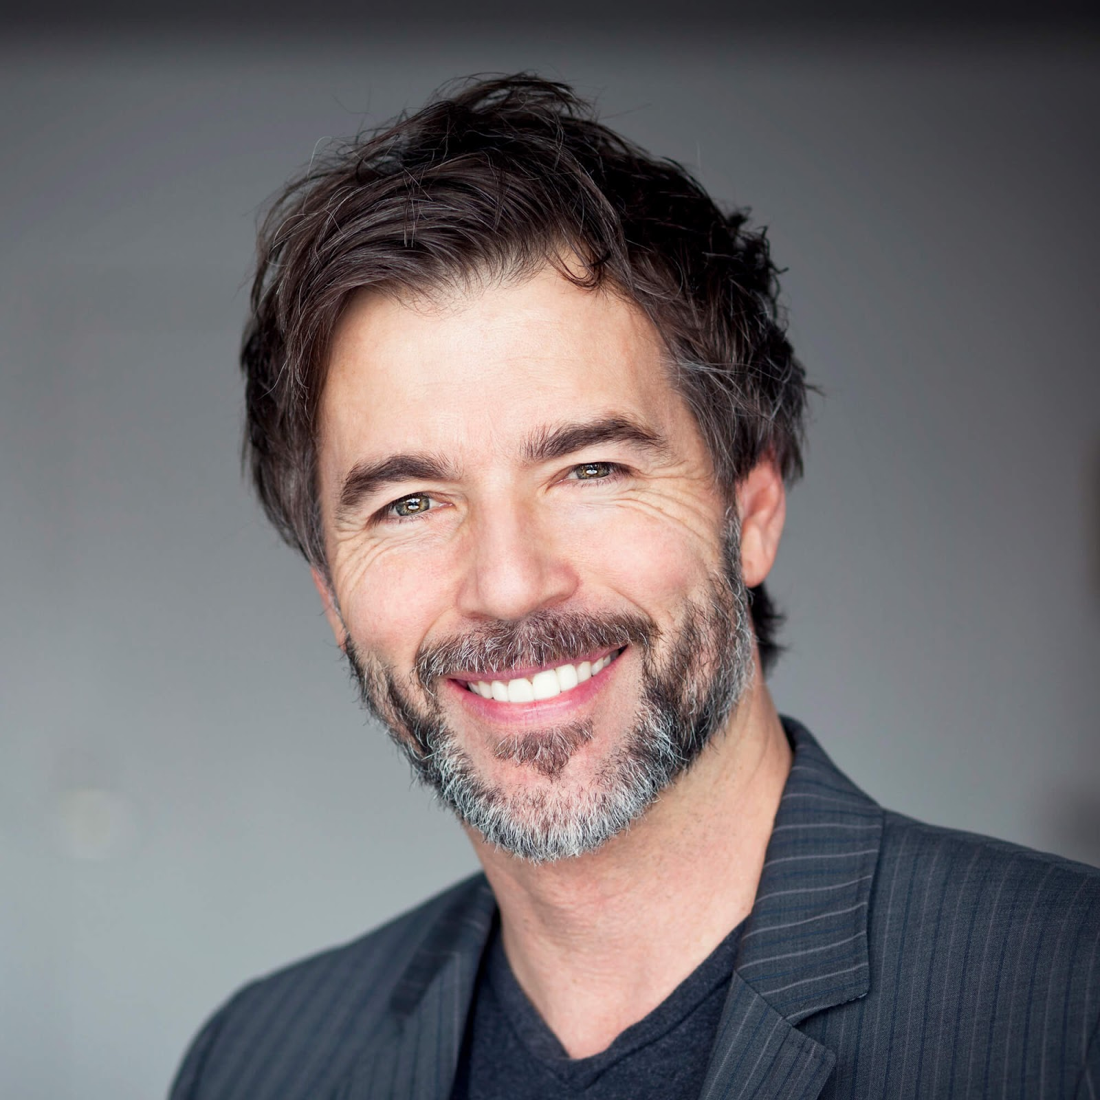
AGE RANGE
GENDER
INCOME
URBANICITY
EDUCATION
PROFESSIONAL ROLE
65-70
Male
80K-500K
Suburban
Bachelor's or Master’s
Doctor, lawyer, engineer, tech executive
Executive Edward
COMPANY SIZE
Background
Edward is a white-collar businessperson in his mid to late 60s. He could be a doctor, lawyer, engineer, or technology professional. He has bachelor's degree—and maybe a master’s—and is primarily focused on investments to grow his wealth as they he looks toward retirement. Edward may seem arrogant and preoccupied because he is very busy.
Goals
Work at a publicly traded company to make enough money to retire in the next five years or less
Find a new financial advisor
Take care of his family financially and make sound investments
Manage stock options
Be financially savvy and portray wealth outwardly
Achieve success at work
Challenges
Doesn’t know how to vet a new advisor
Risk-averse if his net worth is less than $5 million because he’s lost money in other investments. (Risk-seeking if net worth is more than $5 million)
Afraid of making the wrong decision and of change
Recently experienced a life event that requires financing
How Our Company Can Help
Increase average return
Produce incremental returns
Communicate plan details and outcomes during market dips
SMALL
LARGE
BUYING POWER
INFLUENCER
DECISION MAKER
SCHEDULE AVAILABILITY
AMPLE
LIMITED
KEY IDENTIFIERS/JOB ROLE
Doctor
Lawyer
Engineer
Technology professional
RISK TAKER
YES
Maybe
NO
COMPANY ADVOCATE
YES
NO

